Slide 1
Earthquake Forecasting
A Project Presentation For Data Visualization
Name: Md. Naiem Sheikh
B.Sc (Hons) in CSE from SMUCT
GID:G039061
TOP-UP Course On Big Data Analytics

Slide 2
Welcome To Data Visualization Presentation
Today We Will Analyze Dataset Of
“Earthquake”
Which Is Taken From Github
Now We Also Have Kaggle, Data.Gov & More
For Dataset Resources

Slide 3
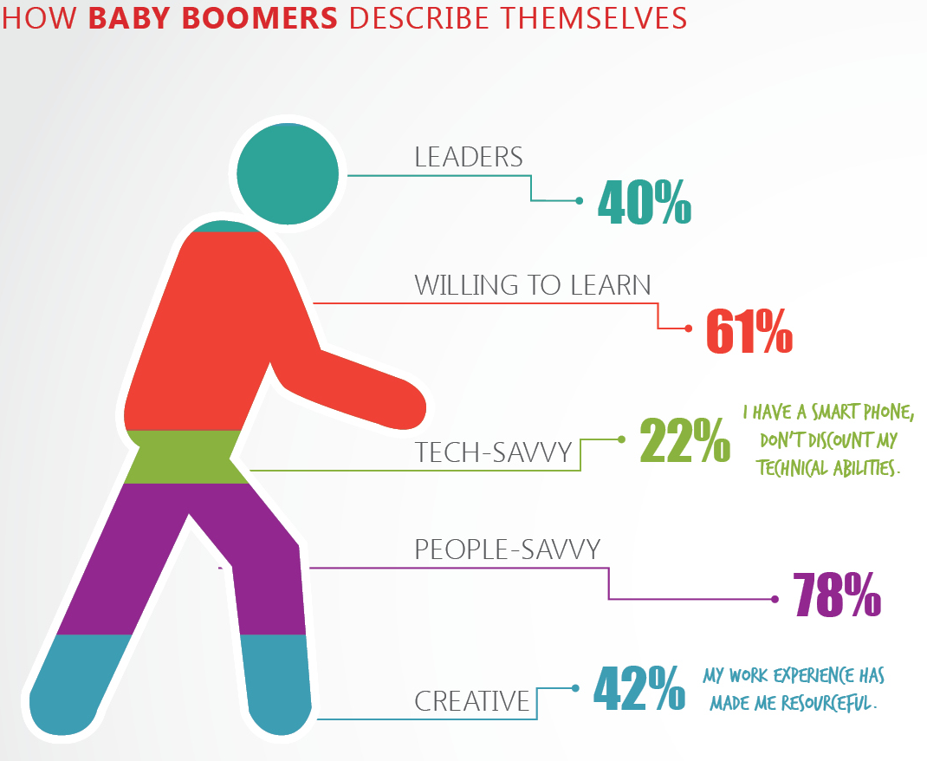
Before Further Discussion We Have To Clear Our Mind About Data Visualization
Data visualization is viewed by many disciplines as a modern equivalent of visual communication. It involves the creation and study of the visual representation of data, meaning "information that has been abstracted in some schematic form, including attributes or variables for the units of information". Example
Percent | Subjects
40 | Leaders
60 | Willing To Learn
78 | People-Savvy
Dataset in Graph (Visualization)
Dataset in Table

Slide 4
“Earthquake”
In This Dataset There Have So Many Info About Earthquake Happens From 1902 To 2011
Now We Have To Check Which Year How Many Times Happen Earthquake Also With Location And Its Forecasting.
Now Times So Many Visualization Tools Available But This Is Done With “Oracle Data Visualization Desktop”.
For This Presentation Area, Bar Chart And Map Graph Are Used
Let's Check

Slide 5
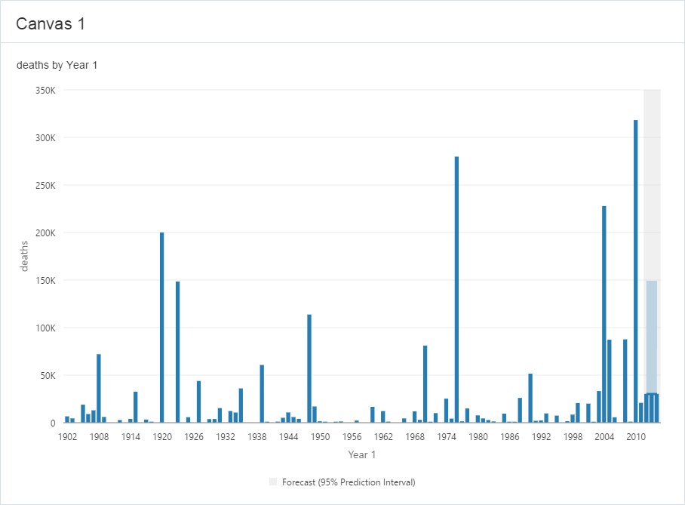
Bar Chart Graph
There have information of year and people died in earthquake. In this graph it is showing forecast of earthquake 2012 to 2013 above people could be possibly death at last 25k. In the Y-axis represent amount of death and X-axis earthquake happens on this year.

Slide 6
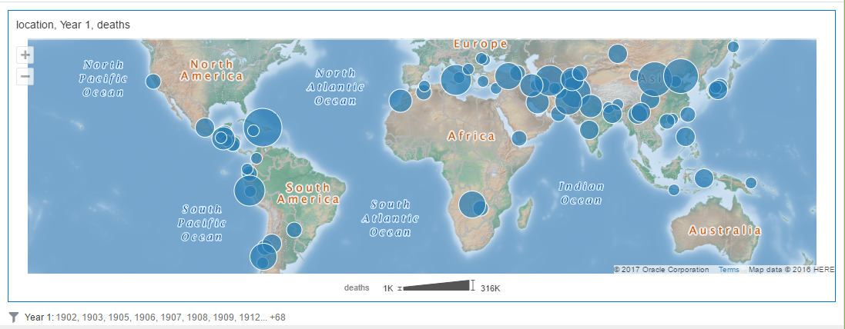
Map Graph
In this map showing location of earthquake and bubbles are indicating amount of death that’s why its called map graph

Slide 7
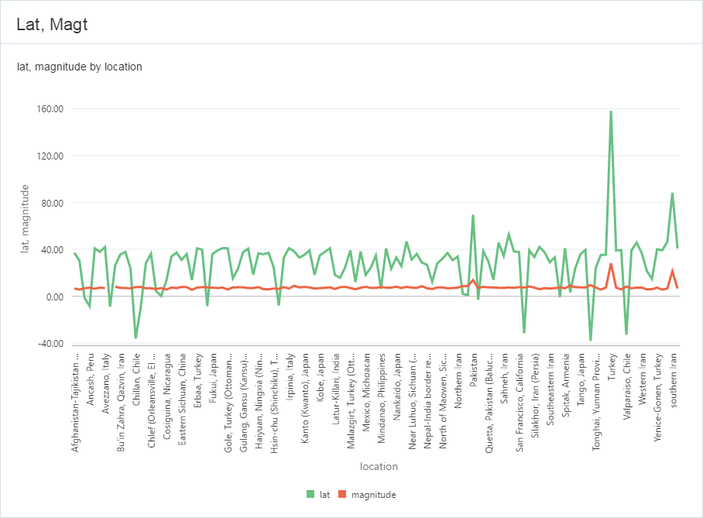
Line Graph
The line graph is presenting Latitude and Magnitude of earthquake happened from 1902 to 2011. The Green line is Latitude which is called lat and Magnitude called magt. Its represent base of line that’s why its called line graph. X-axis showing location and Y-axis showing Latitude and Magnitude.

Slide 8
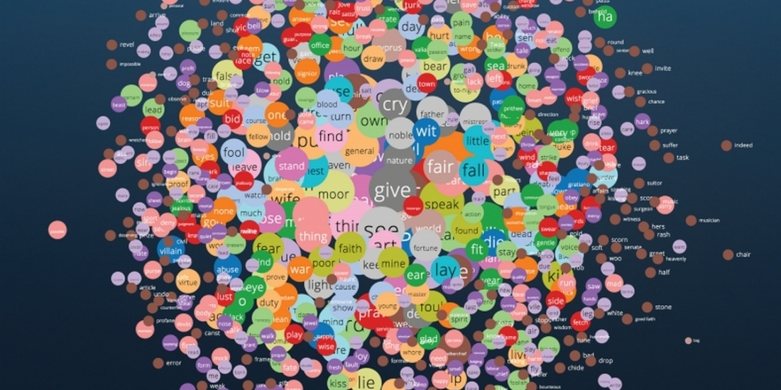
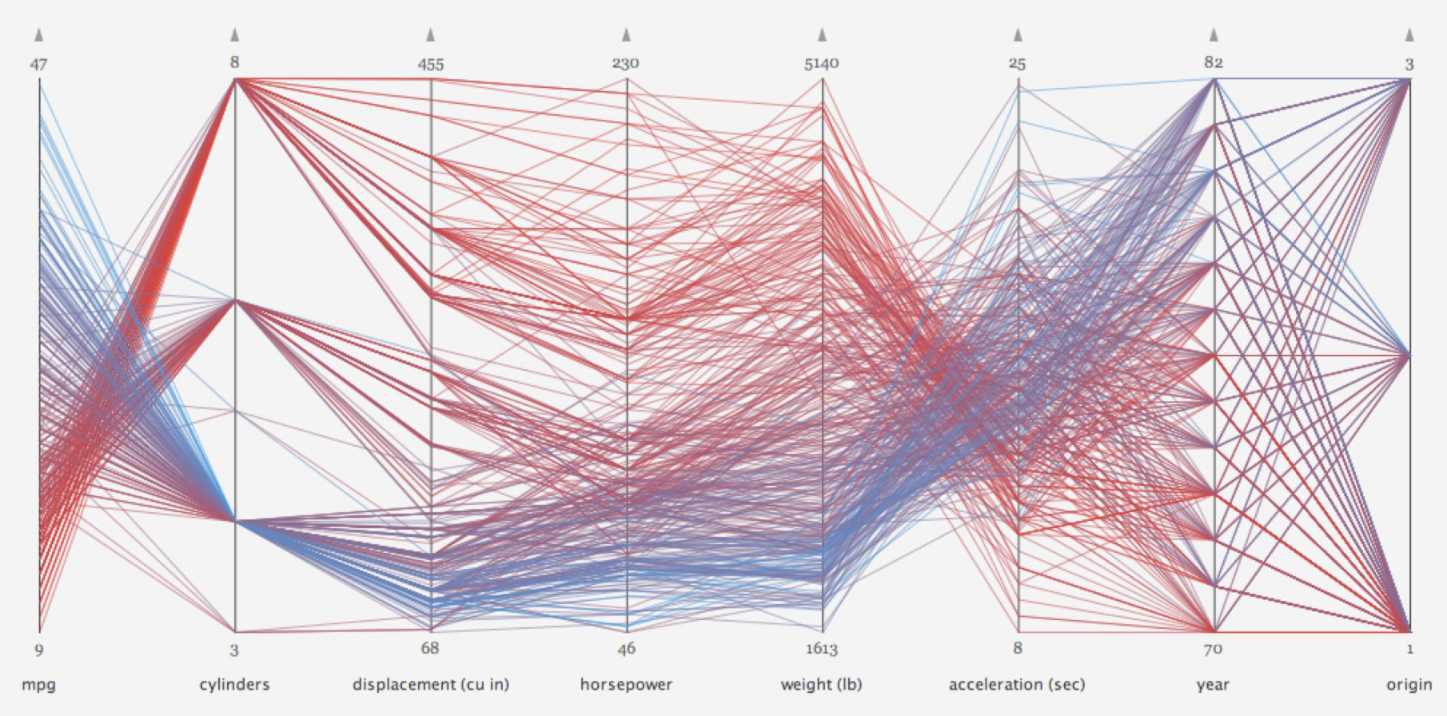
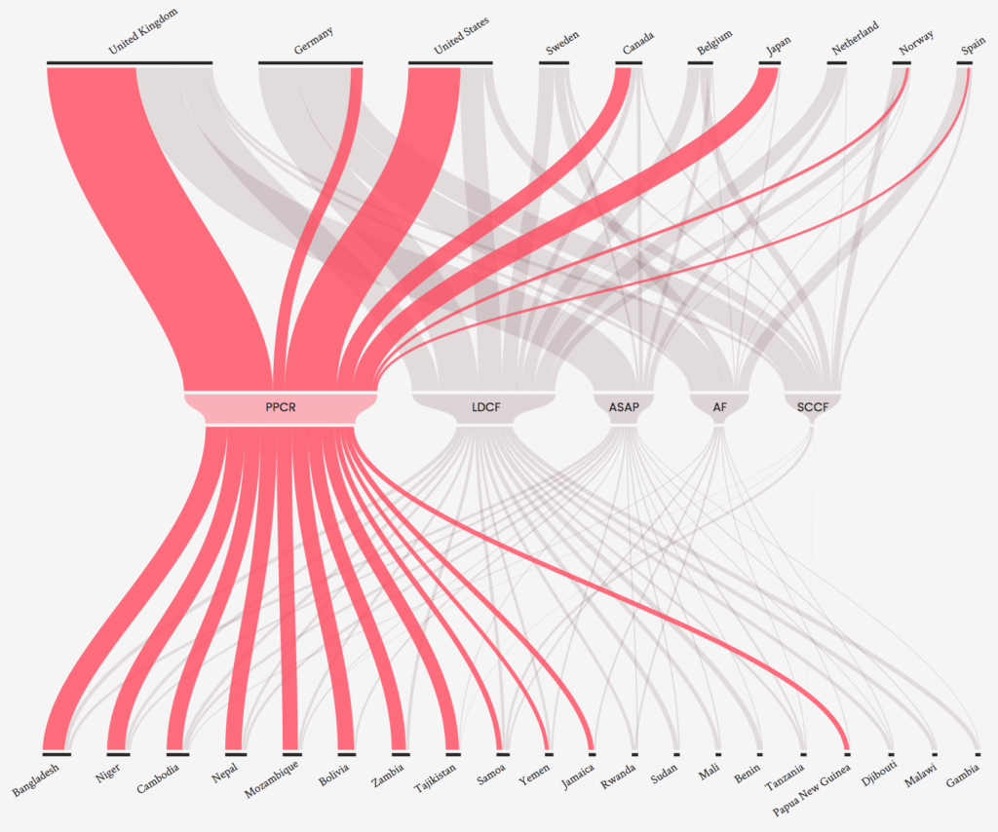
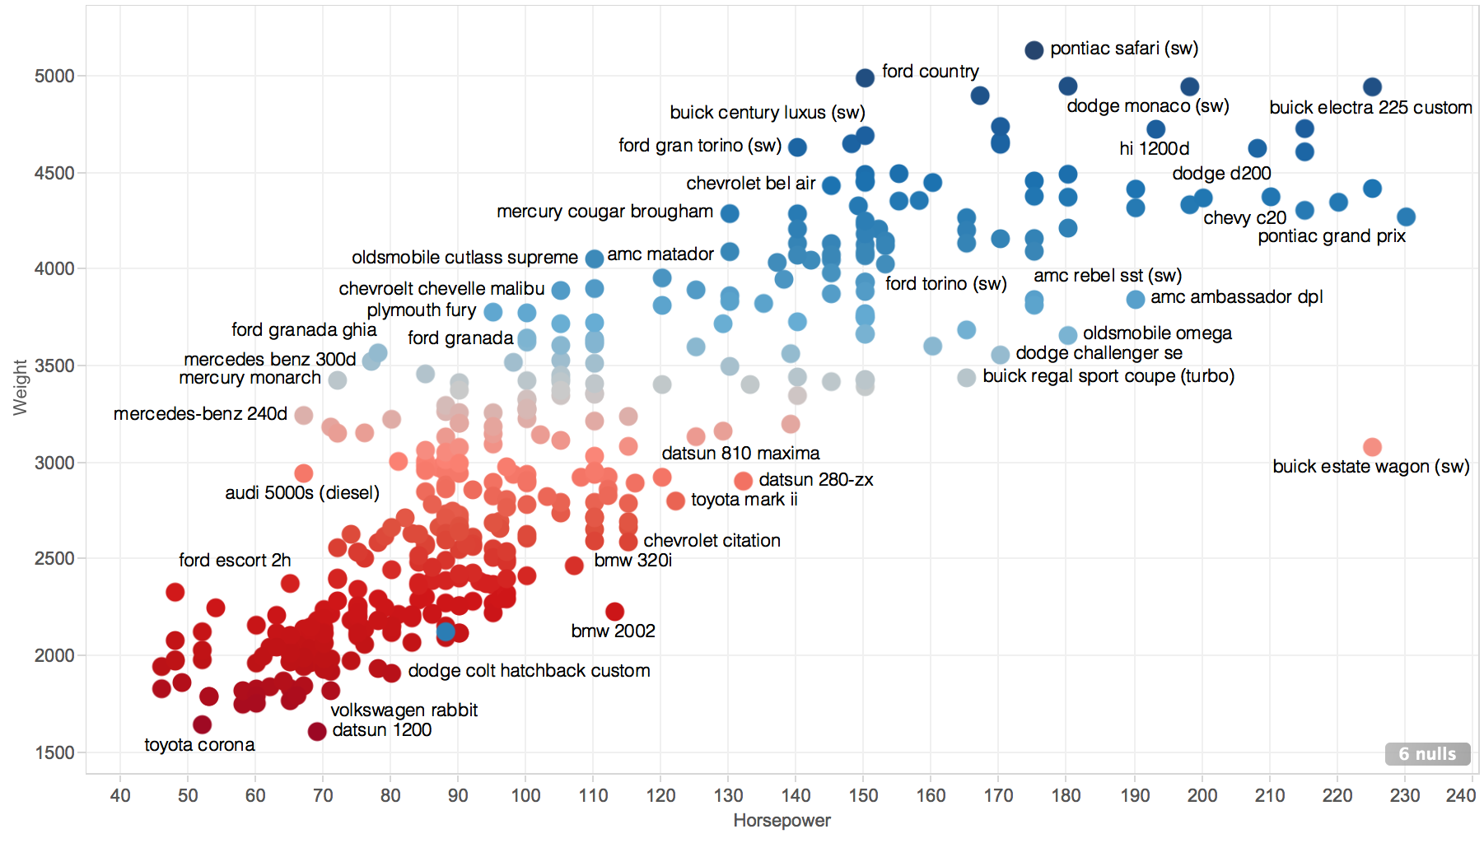
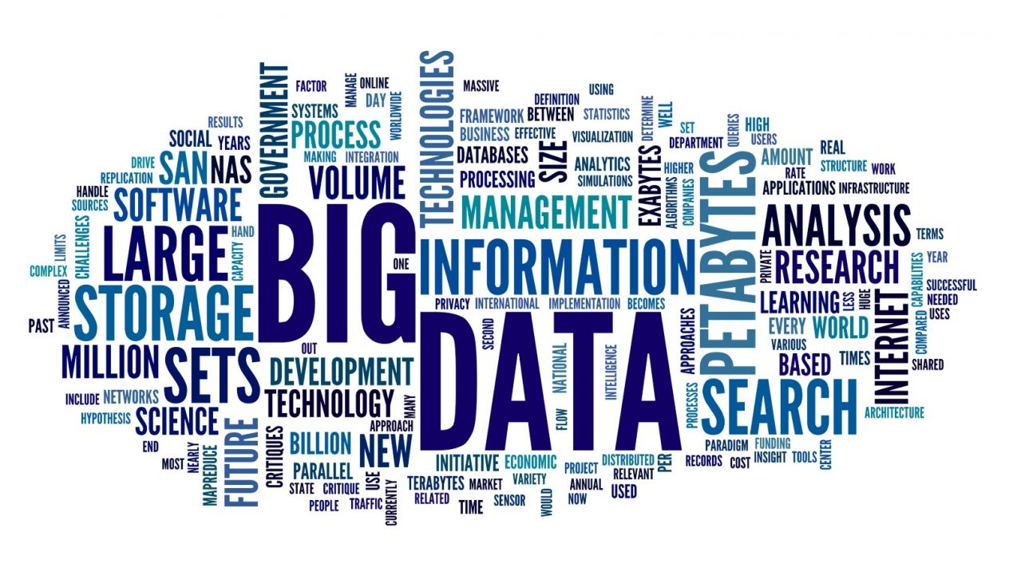
There are so many graphs like bellow
Bubble graph
Scatter graph
Parallel graph
Sankey
Tag Cloud graph

Slide 9
Thank You

